Slide 1
FACE RECOGNITION USING
RASPBERRY PI
SURYA KAUSHIK(ECE/078)
B.RAVI KISHORE REDDY (ECE/092)
YASHWANTH (ECE/119)

Slide 2
CONTENTS
Introduction
Problem Definition Proposed Solution Project Description Project Planning Hardware Requirements Software Requirements The Program
Challenges during execution
Conclusion Future Work

Slide 3
INTRODUCTION
The human face plays an important role in our social interaction, conveying people’s identity. Using the human face as a key to security, biometric face recognition technology has received significant attention in the past several years due to its potential for a wide variety of applications in both law enforcement and non-law enforcement.
As compared with other biometrics systems using fingerprint/palmprint and iris, face recognition has distinct advantages because of its non-contact process. Face images can be captured from a distance without touching the person being identified, and the identification does not require interacting with the person. In addition, face recognition serves the crime deterrent purpose because face images that have been recorded and archived can later help identify a person.

Slide 4
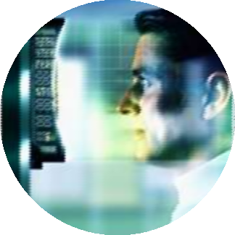
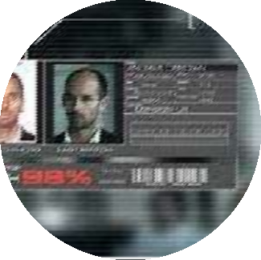
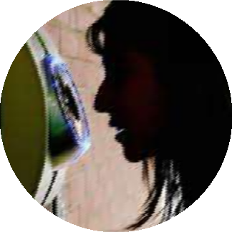
INTRODUCTION: USES
Office Security
Facial recognition used as a security measure to keep a check on the office workers.
Criminal Identification
Facial Recognition can be used to detect and locate criminals by the law enforcements.
Personal Uses
Facial Recognition can be used to protect our belongings from our home to our safes.

Slide 5
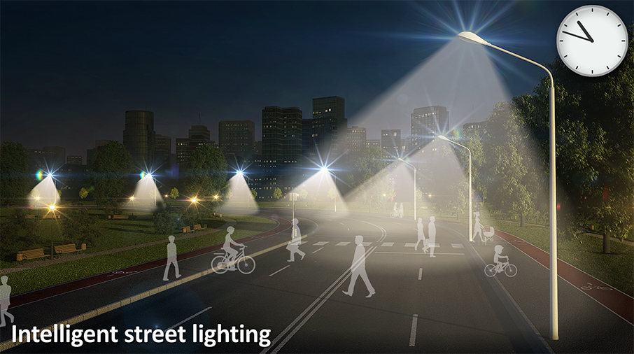
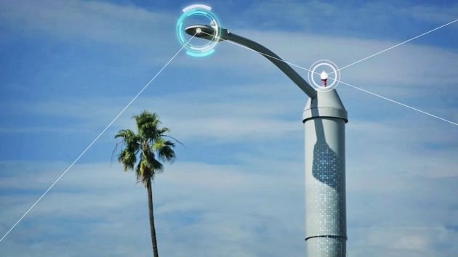

Verification
Acknowledgment
Control unit

Slide 6
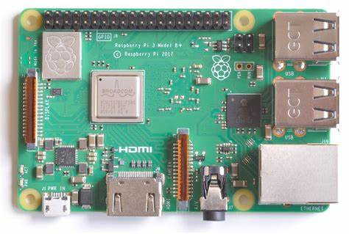
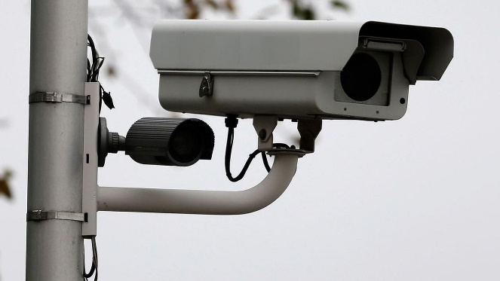
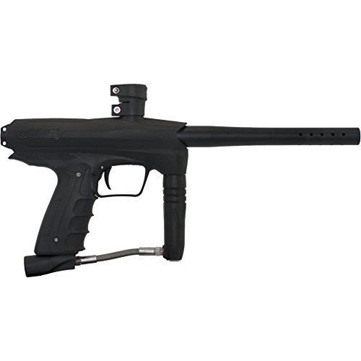
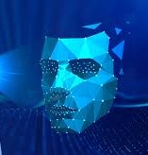
Raspberry pi 3 Model B+
CSI Camera port
BCM43438 wireless LAN
100 Base Ethernet
Memory
GPIO
Control unit
Relay
SECURITY Database
Electronic based Gun

Slide 7
PROBLEM DEFINITION
To provide a stable and cost effective system that can be used for facial recognition on a commercial basis at different levels of security.

Slide 8
PROPOSED SOLUTION
To provide to the above stated problem, we propose to use raspberry pi as cost effective but efficient solution for facial recognition.
Raspberry pi will be accompanied by a several hardware and software components to such as python(programming language) and a webcam to help get input and detect faces.

Slide 9
PROJECT DESCRIPTION
Linux was used as the operating system with
The basic idea was to develop a cost effective but efficient system for facial recognition
python as the programming language for the facial recognition system source code.
A website was developed as the output to the system
We have used raspberry pi as the processing unit for the facial recognition system
A web camera was used to take facial image as input for the system
Following are the details of the project:

Slide 10
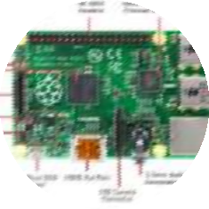
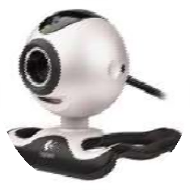

HARDWARE REQUIREMENTS
Raspberry pi: It will be used as processing machine for the openCV
Raspi-Camera: Used to capture image
Keyboard: to input code data and to write code

Slide 11
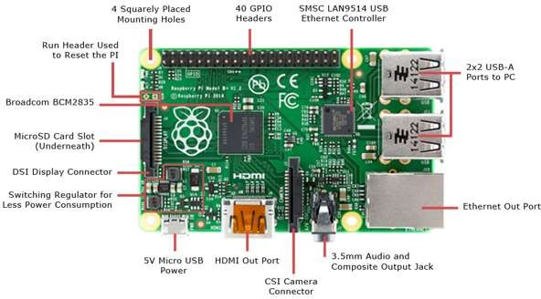
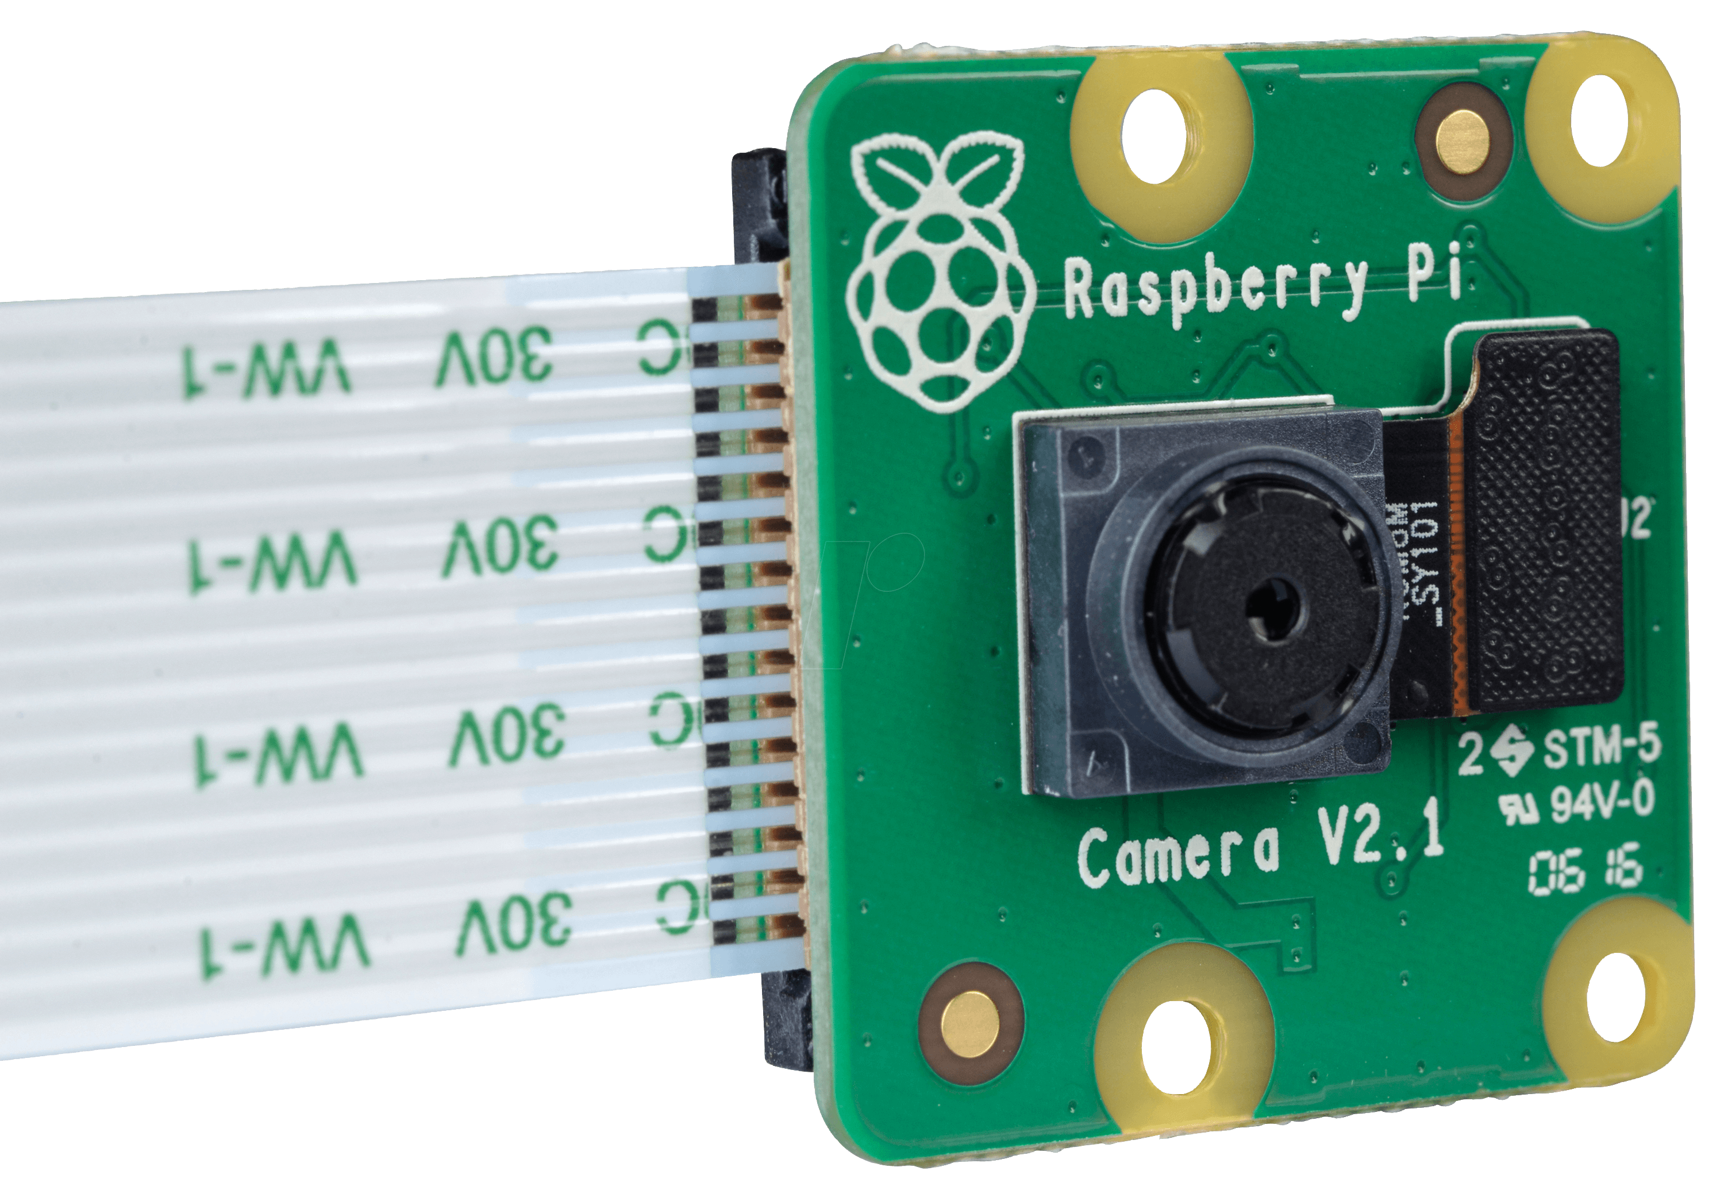
HARDWARE REQUIREMENTS: RASPBERRY PI
Pi - Camera, 8MP
v2.1, IMX219PQ
Raspberry Pi – Model 3B

Slide 12
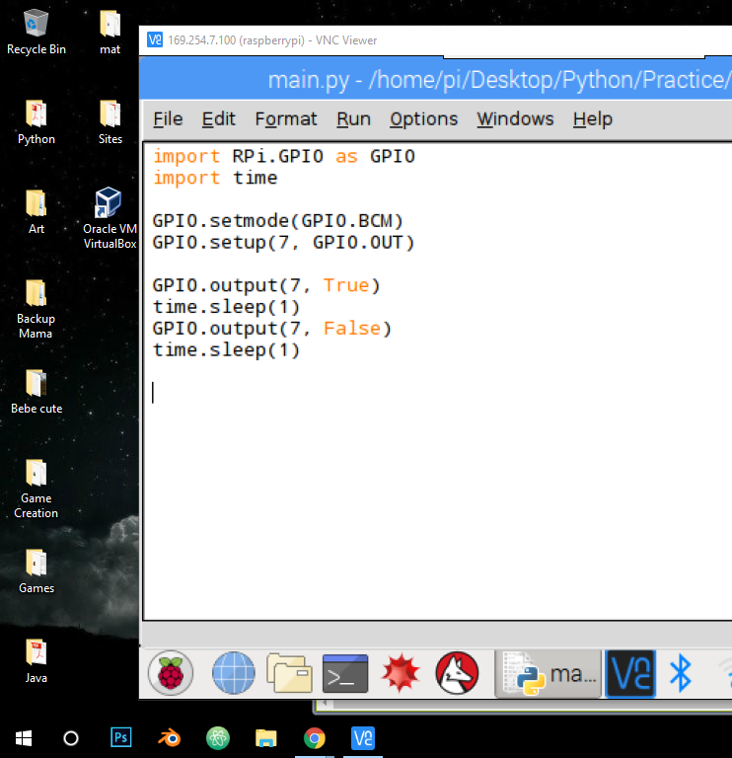
import RPi.GPIO as GPIO import time GPIO.setmode(GPIO.BOARD) GPIO.setup(7, GPIO.OUT) GPIO.output(7, True) time.sleep(1)
GPIO.output(7, False) time.sleep(1)
GPIO.cleanup()

Slide 13
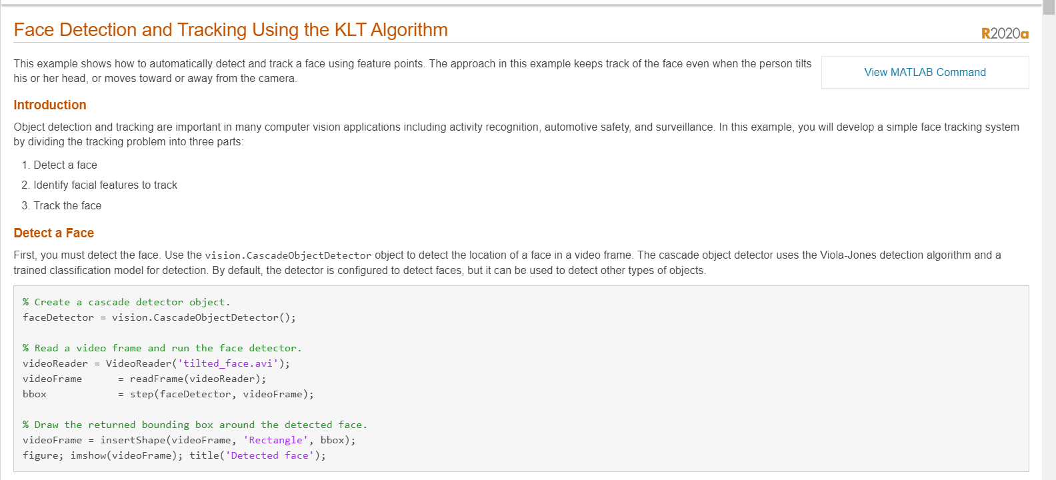

Slide 14
SOFTWARE REQUIREMENTS
The raspberry pi needed to be installed with python 2.7 and OpenCV 2.4 to process the image.
The Opencv /MATLAB contains the necessary classes for eigenvalue face recognition and the python IDE can be used for implementing the embedded code
The webcam software that we needed to install for the raspberry pi was fswebcam. It is a free and open source software that downloads and installs the necessary drivers for webcam to be operated successfully on a linux machine.
Certain libraries were needed to be downloaded and installed separately for the system to function properly

Slide 15









THE PROGRAM
The program is written in python with opencv embedded.
Python was chosen for it’s ease of embedding opencv as well as it’s IDE being made available for the raspberry pi( the device for processing data).
The code has 3 major parts:
Capture_positives.py: This file contains the code to capture and detect a face . Once that is done the face is cropped
out , the image desaturated and saved to a directory named positives
Train.py: this code makes use of the captured images to train the data into an xml file and create 3 further images ,
namely- mean, positive and negative(based on lightning of the pixel).
Box.py: This portion of code loads the training data and tries to detect and further recognize a face

Slide 16
THE CHALLENGES
As the number of positive outcomes is limited by the number of photos and the lightning effects at the time of photo capture the photo must be captured in all possible lightning condition with varying facial expression
For better recognition we have added the face data as negative for recognition. This provides as the basis for negating an image
The use of a display screen was limited by its high cost, a more economical alternative is still being searched and could be incorporated in next build of the system.
We tried to implement whatsapp/telegram messaging services within the setup. However, although we were able to send messages but the encryption of the applications forced us to verify the mobile number via sms each and every time we logged into the system.

Slide 17
AFTER RECOGNITION
After the face is recognized the captured image is displayed in a window name “Welcome”.
This then further reroutes to a site where we have collected experiences in making the project and displayed it’s working.

Slide 18


FUTURE WORK
The group is looking on to the future application of the build project with particular interest in the area of biometric security of different devices like Smartphone or college labs. Discussion are regularly being held with our mentor and various other concerned officials of college administration department. An active display screen is a sure feature on the next iteration of the build system and higher accuracy in facial recognition with optimizing the response time is also discussed with the mentor.

